Slide 1





predicting movie ratings using machine learning
by Celine Antrazi

Slide 2



Background
Movie platforms often rely on user reviews and ratings to recommend content. Predicting movie ratings based on features like genre, votes, and duration can improve user experience and aid in content recommendation.

Slide 3


Problem
Manually predicting a movie’s success or rating is subjective. The goal is to use machine learning to predict movie ratings based on objective features, helping streaming platforms recommend content and understand viewer preferences.

Slide 4

dataset
source: Kaggle
records: 9,958
features: title-year-certificate-duration-genre-rating-description-stars-votes

Slide 5


approach
data cleaning
preprocessing
modeling
evaluation

Slide 6
use case
a movie platform/streaming service like Netflix can use predicted ratings to rank new releases, improve user satisfaction, and make data-driven content investments

Slide 7
practical applications
purpose | explanation
recommendation systems | help streaming platforms suggest movies based on predicted ratings
business decision support | guide producers or platforms on which movies are likely to succeed
understand feature impact | identify what factors influence ratings most (genre, actors…)
automation | replace manual reviews with data-driven insights for faster predictions
marketing and promotion | predict high-rated movies to focus advertising efforts effectively
content strategy | help producers/platforms decide which genres/actors to invest in
early insights for new movies | predict ratings before launch based on known features

Slide 8

data cleaning
handled missing values
removed duplicates
filled missing values
year: mode
certificate: ‘Unknown’
duration: mean per genre
genre: mode
rating: mean
votes: converted to numeric, filled with 0
handled outliers in votes, duration using clipping

Slide 9
feature engineering
created new features
decade = (year//10) * 10
age = 2025 – year
lead_actor extracted from stars
preprocessing
one-hot encoded: genre, certificate, lead_actor
scaled numeric features: year, duration, votes, decade, age

Slide 10
models I used
linear regression
feature scaling
adding more features
random forest regressor
hyperparameter tuning
gradient boosting regression
3) KNN regression

Slide 11
linear regression
what it does:
why I used it:
a simple, baseline model that assumes a straight-line relationship between the input features (year, duration, votes) and the target variable (rating). it tries to find the best-fit line that minimizes prediction errors
I used linear regression as a starting point to understand how well a simple model could perform on my dataset. it served as a baseline to compare with more complex models. its low performance helped me realize the need for non-linear models

Slide 12
random forest regressor
what it does:
why I used it:
an ensemble model that builds many decision trees and averages their results for a more accurate prediction. it captures non-linear relationships and handles outliers and feature interactions better than linear regression
I used random forest to improve prediction accuracy by leveraging its ability to handle complex patterns in the data. it gave significantly better results than linear regression and provided insights into gradient boosting importance

Slide 13
K-Nearest Neighbors (KNN) regressor
what it does:
why I used it:
a distance-based model that predicts the rating of a movie by averaging the ratings of its closest similar movies (neighbors). it doesn’t assume any pattern but relies on data similarity
KNN was used to explore a simple, non-parametric method that predicts based on similarity, offering a contrast to tree-based models. while it performed worse than random forest, it provided a useful perspective on local patterns in the data

Slide 14
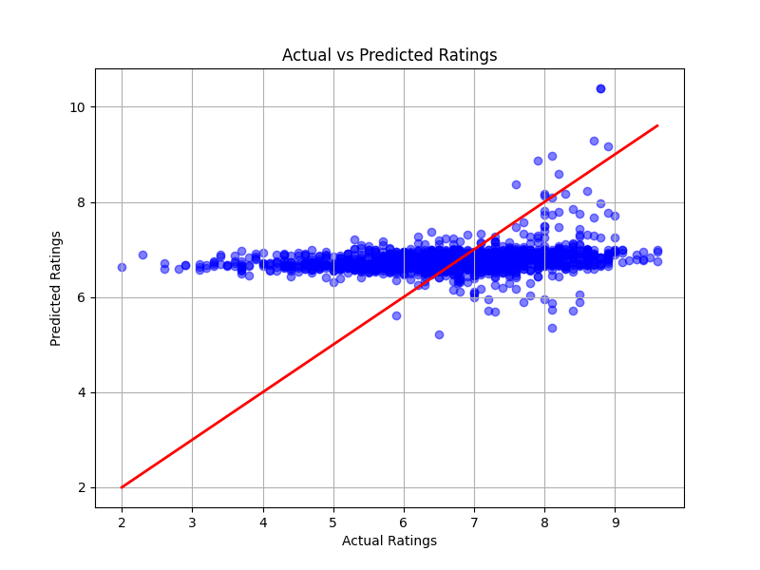
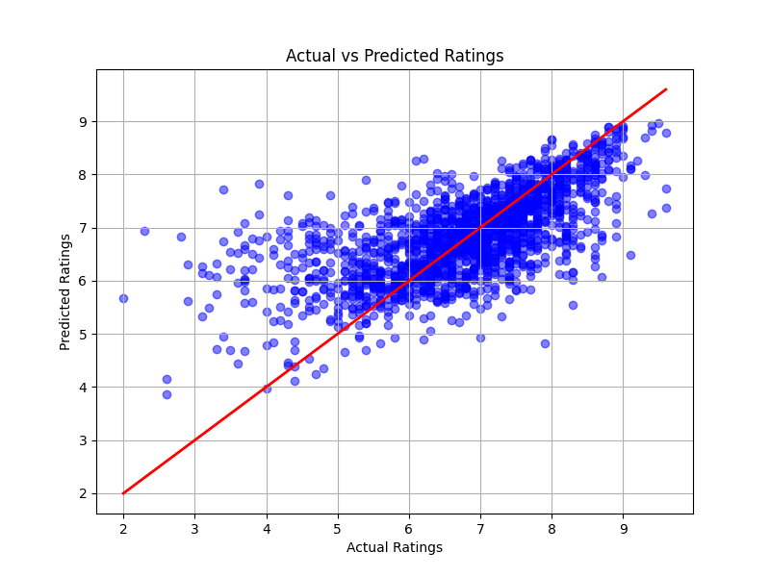
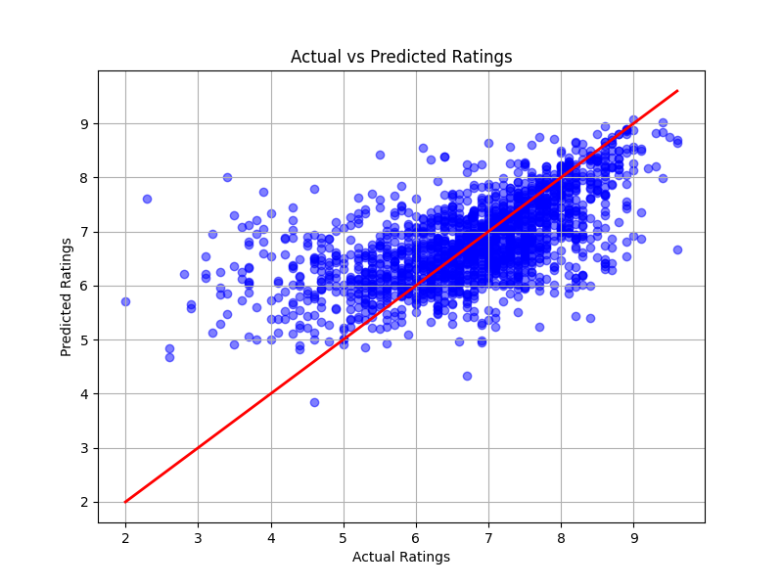
results
linear regression
Mean Squared Error: 1.2185589827444225
R^2 Score: 0.05904706361050771
random forest
Mean Squared Error: 0.732435411852444
R^2 Score: 0.4344243805531467
KNN regressor
Mean Squared Error: 0.8240255364513894
R^2 Score: 0.3636998625724419

Slide 15
conclusion
gradient boosting regressor performed in random forest is the best model as it has the highest R² Score and lowest MSE

Slide 16
Sar fikon tza2fo

